Slide 1

Stock Predictions
To Bull Or To Bear?

Slide 2

PROJECT OVERVIEW
Stock Predictions
MACHINE LEARNING
Buy, Sell or Hold?
Using Yahoo! Finance API Published To Azure Web Service
SVR Algorithm
Accuracy Model
VISUALIZATIONS
SENTIMENT ANALYSIS
AI Stock Analysis Using Tableau
Percentage Trend Using NLTK News API Library

Slide 3

PROJECT TEAM
About
Soo Bin Im
Meardreed Vilmeus
Max Young
Priya Jain
GitHub Repository
https://github.com/priyajainnyc/final-group-project-4-azure

Slide 4

AI STOCK PREDICTIONS
BUY
HOLD
SELL
25 Buy Recommendations with Total Market Cap of $14.56B
26 Hold Recommendations with Total Market Cap of $2.34B
21 Sell Recommendations with Total Market Cap of $580M

Slide 5

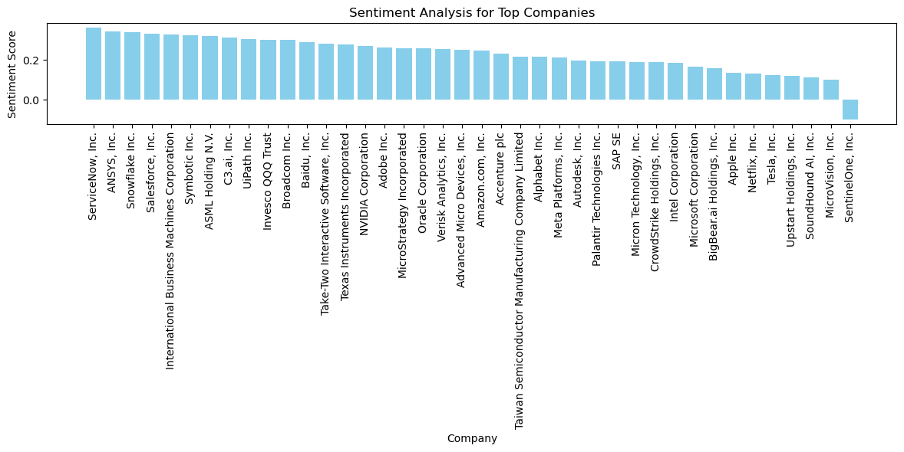
COMPANY OVERVIEW

Slide 6

Thank You
Questions?

Slide 7

DEPENDENCIES
- Dash API, with HTML and CSS
- Flask
- Python
- Pandas
- Numpy
- Plotly
- yfinance
- nltk
- Scikit-learn
- Tableau
- Azure Web Services
$2B
Dash
HTML
CSS
Flask
NLTK Library
Yahoo! Finance API
Finwiz Data
Tableau
Azure Web Services

Slide 8

SOLUTION
CLOSE THE GAP
Our productmakes investing and portfolio management easier, and no other product on the market offers the same benefits
TARGET AUDIENCE
Professional investors
COST SAVINGS
Reduce costs for client by helping businesses increase their profits in the stock market
EASY TO USE
A simple product that gives businesses the information they need in order to make informed financial decisions

Slide 9

OUR COMPETITION
CONTOSO
COMPETITORS
Our product is priced below that of other financial management tools on the market
Simple and easy to use app and website, compared to the complex tools of the competitors
Affordability is the main draw for our consumers to our product
Company A Product is more expensive
Companies B & C Product is expensive and inconvenient to use
Companies D & E Product is affordable, but inconvenient to use

Slide 10

GROWTH STRATEGY
How we’ll scale in the future
FEB 20XX
MAY 20XX
OCT 20XX
Roll out product to local businesses to help establish the product
Release the product to the general public and monitor stock market trends
Gather feedback from the financial community to expand availability of the product

Slide 11

SUMMARY
At Contoso, we believe in giving 110%. By closing the loop on investment management and using the latest technology, we help businesses grow and expand their portfolio funds. We thrive because of our market knowledge and a great team behind our product. As our CEO says, "Efficiencies will come from proactively transforming how we do business."

